Slide 1
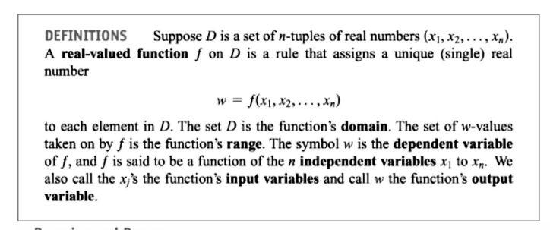
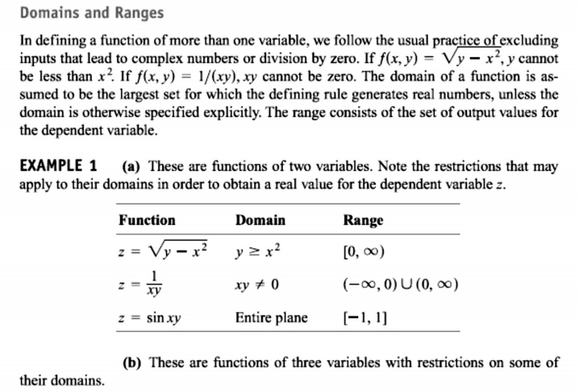
1 / Dep. Of Engineering Mechanics
th
Class: 2 AMTHMATICS / T he Partial Derivatives

Slide 2
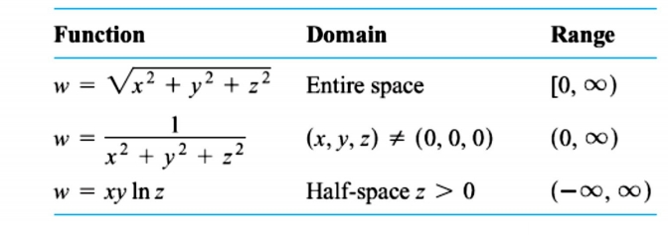
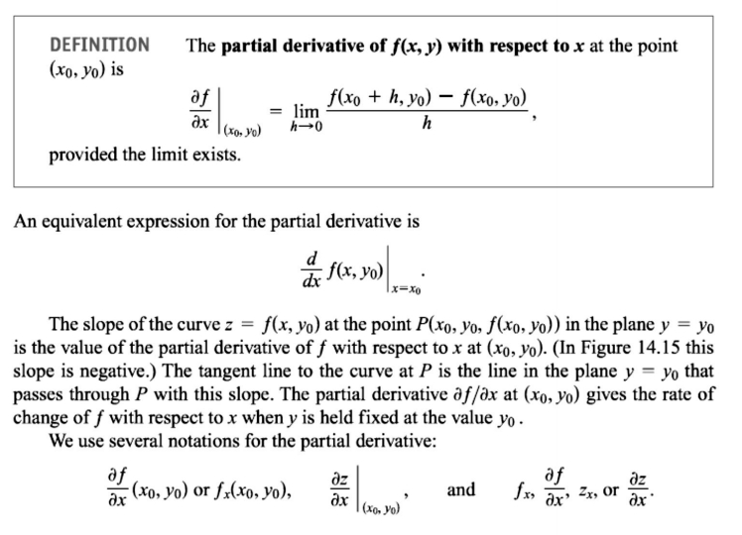
2 / Dep. Of Engineering Mechanics
th
Class: 2 AMTHMATICS / T he Partial Derivatives

Slide 3
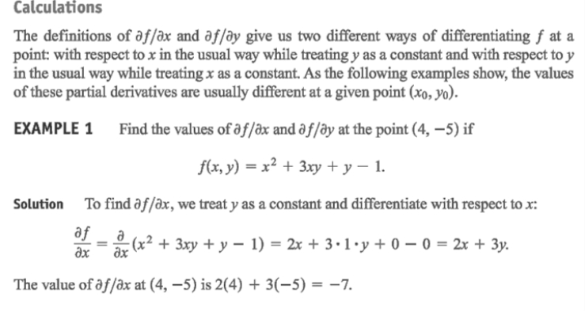
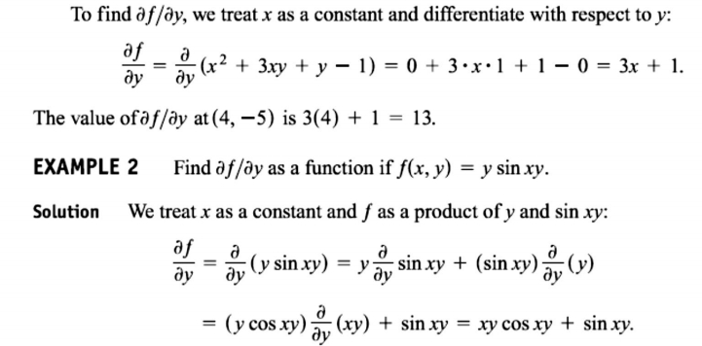
3 / Dep. Of Engineering Mechanics
th
Class: 2 AMTHMATICS / T he Partial Derivatives

Slide 4
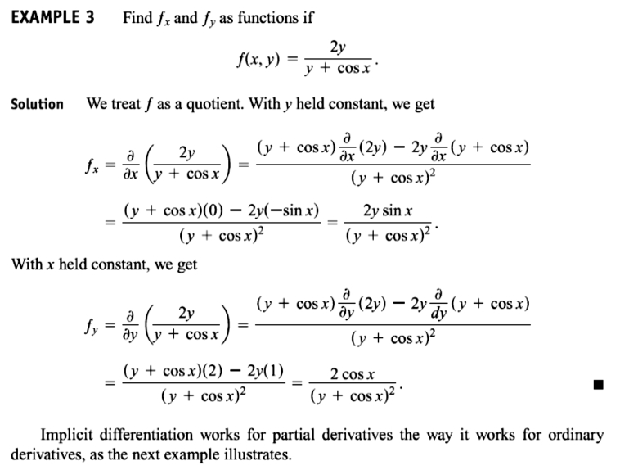
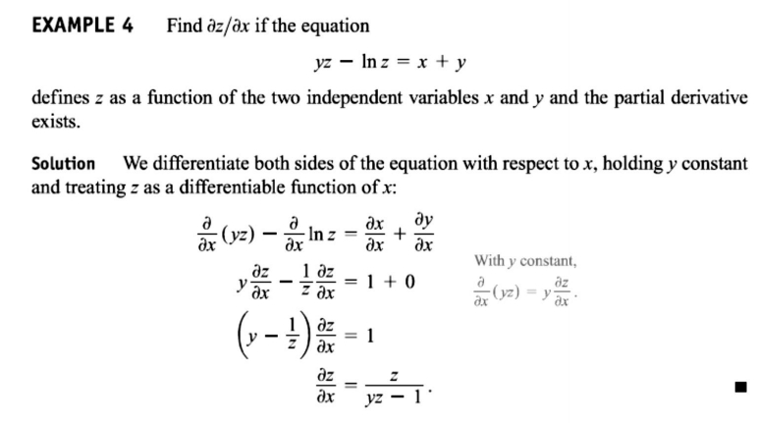
4 / Dep. Of Engineering Mechanics
th
Class: 2 AMTHMATICS / T he Partial Derivatives

Slide 5
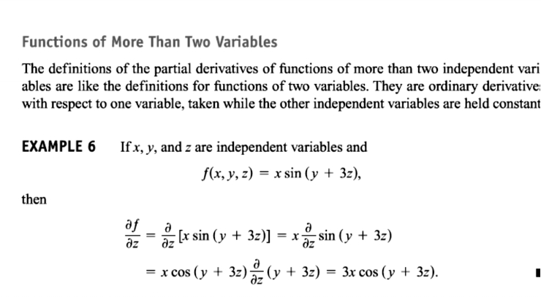
5 / Dep. Of Engineering Mechanics
th
Class: 2 AMTHMATICS / T he Partial Derivatives

Slide 6
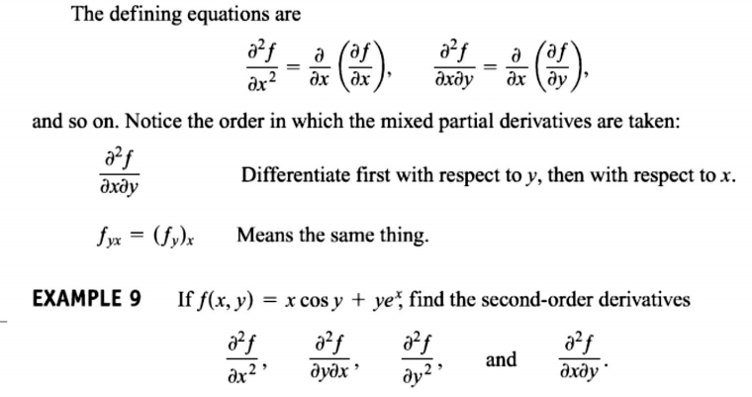
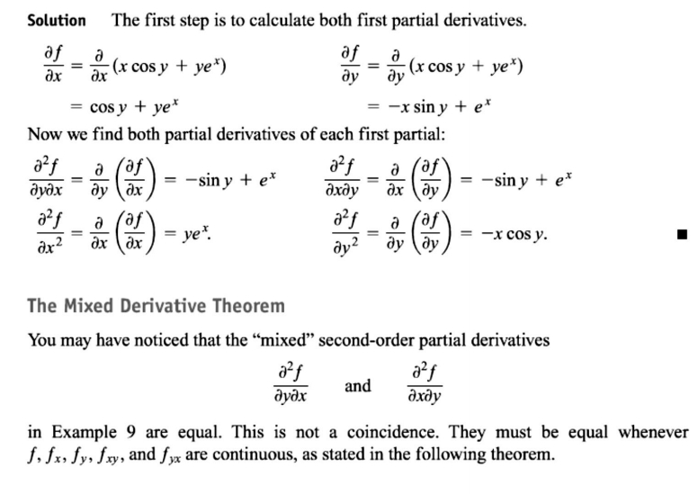
6 / Dep. Of Engineering Mechanics
th
Class: 2 AMTHMATICS / T he Partial Derivatives

Slide 7
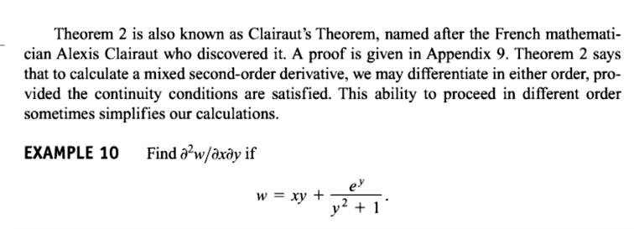
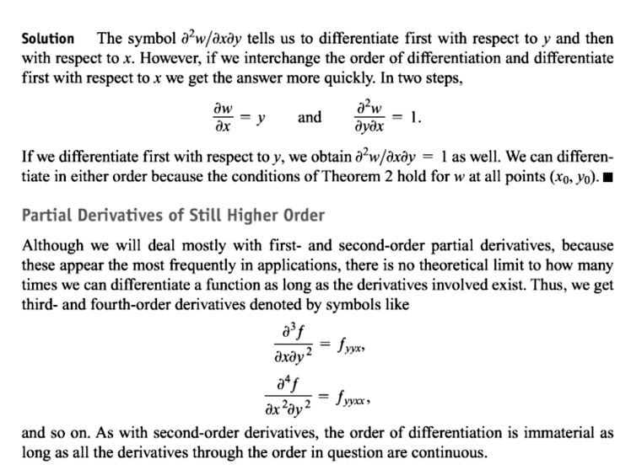
7 / Dep. Of Engineering Mechanics
th
Class: 2 AMTHMATICS / T he Partial Derivatives

Slide 8
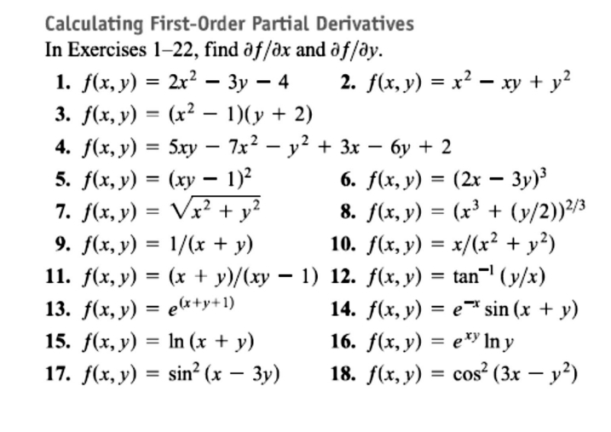
8 / Dep. Of Engineering Mechanics
th
Class: 2 AMTHMATICS / T he Partial Derivatives

Slide 9
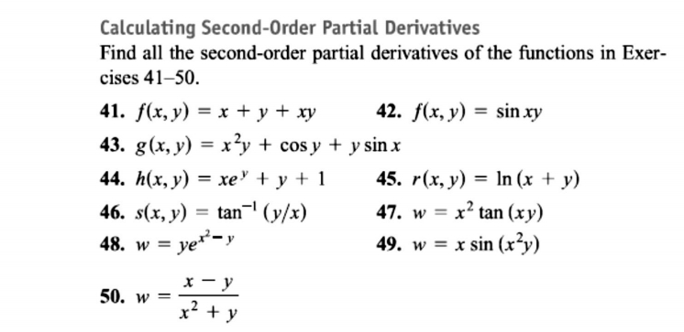
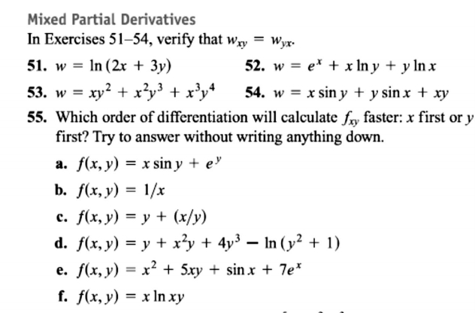
9 / Dep. Of Engineering Mechanics
th
Class: 2 AMTHMATICS / T he Partial Derivatives

Slide 10
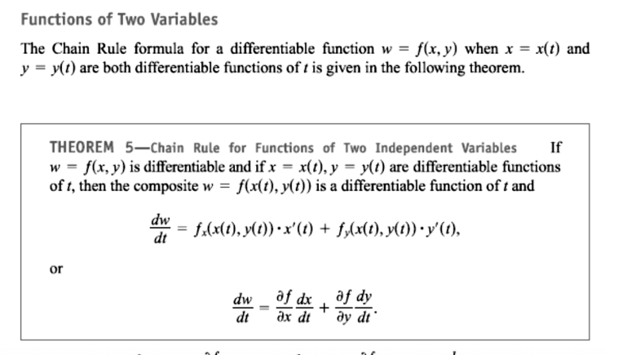
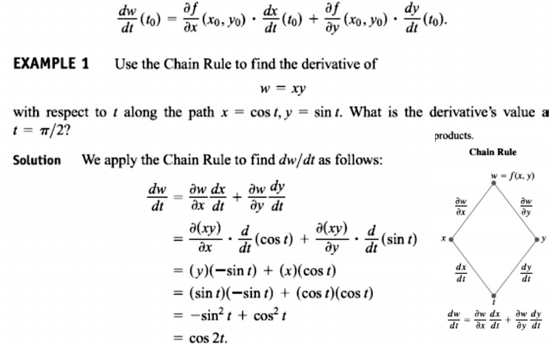
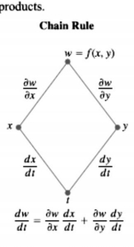
10 / Dep. Of Engineering Mechanics
th
Class: 2 AMTHMATICS / T he Partial Derivatives

Slide 11
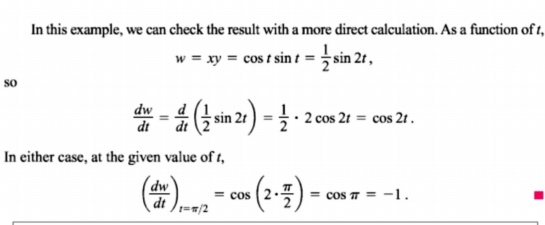
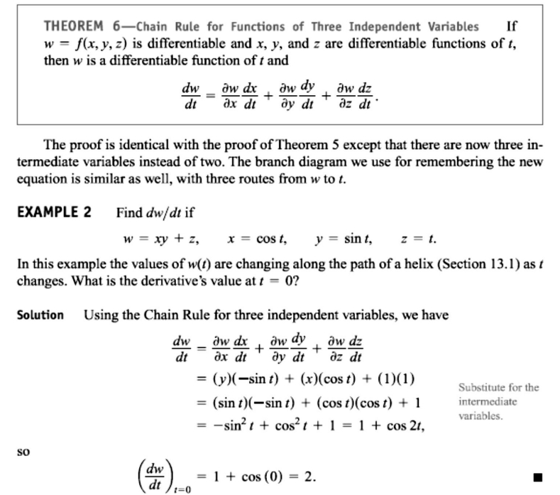
11 / Dep. Of Engineering Mechanics
th
Class: 2 AMTHMATICS / T he Partial Derivatives

Slide 12
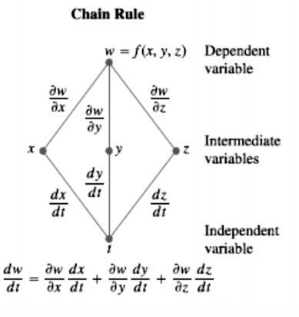
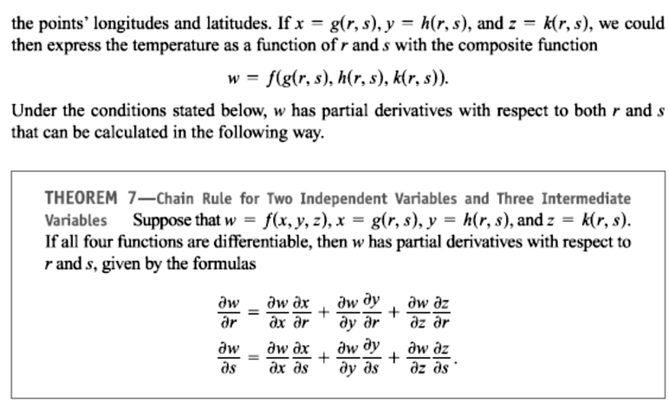
12 / Dep. Of Engineering Mechanics
th
Class: 2 AMTHMATICS / T he Partial Derivatives

Slide 13
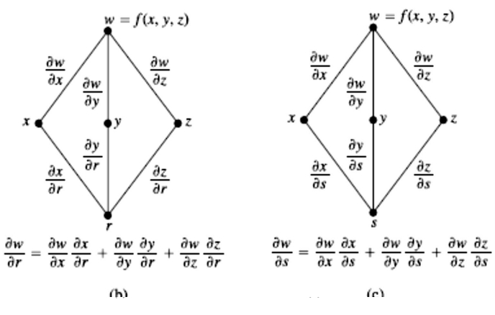
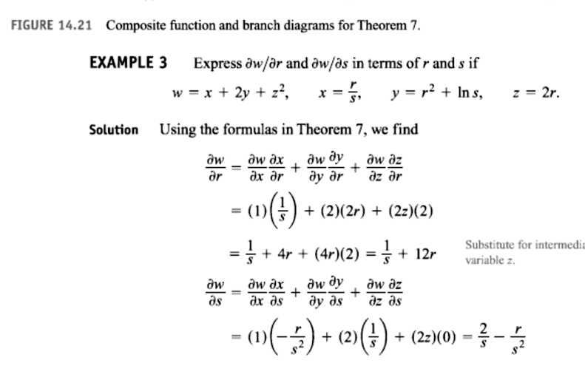
13 / Dep. Of Engineering Mechanics
th
Class: 2 AMTHMATICS / T he Partial Derivatives

Slide 14
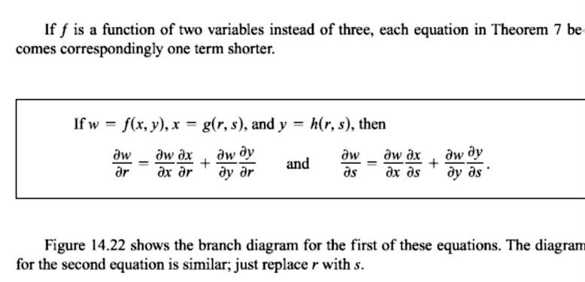
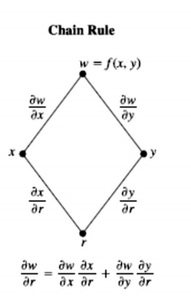
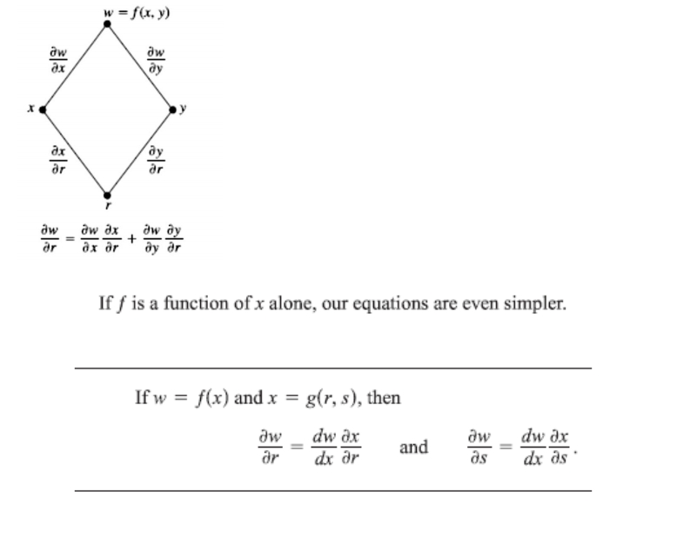
14 / Dep. Of Engineering Mechanics
th
Class: 2 AMTHMATICS / T he Partial Derivatives

Slide 15
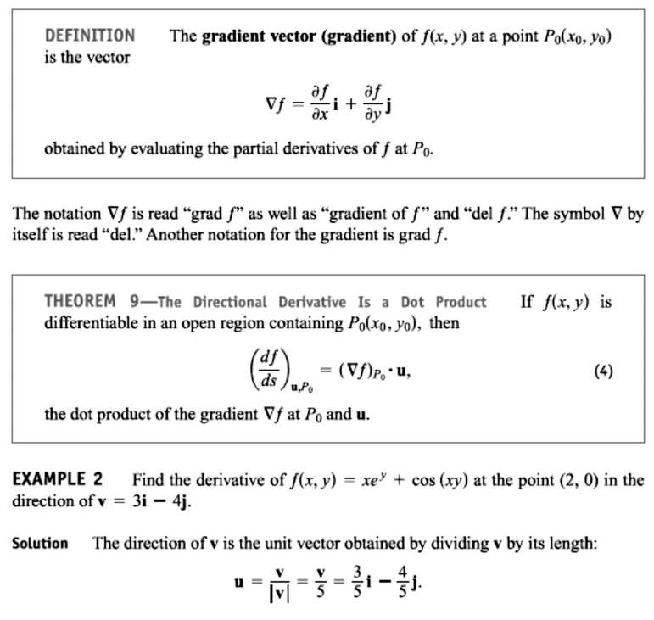
15 / Dep. Of Engineering Mechanics
th
Class: 2 AMTHMATICS / T he Partial Derivatives

Slide 16
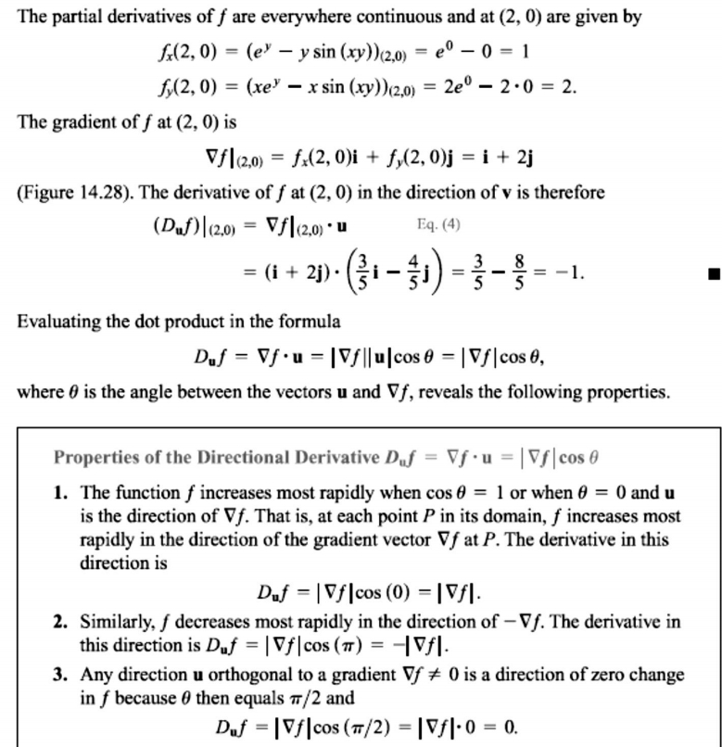
16 / Dep. Of Engineering Mechanics
th
Class: 2 AMTHMATICS / T he Partial Derivatives

Slide 17
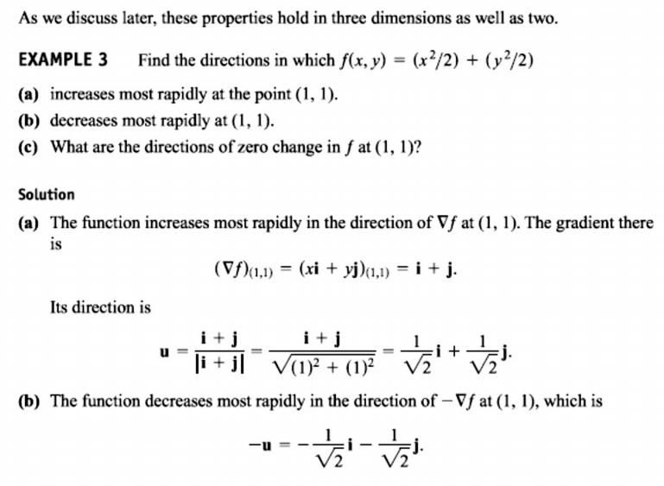
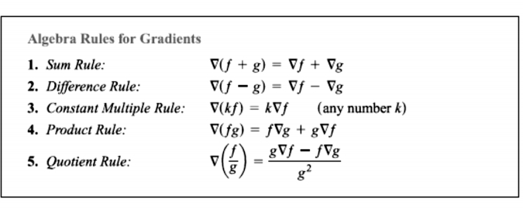
17 / Dep. Of Engineering Mechanics
th
Class: 2 AMTHMATICS / T he Partial Derivatives

Slide 18
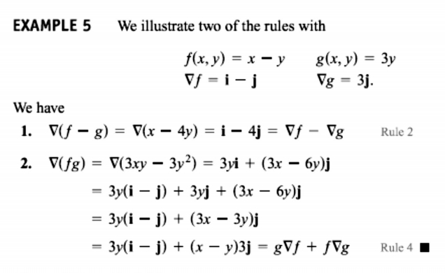
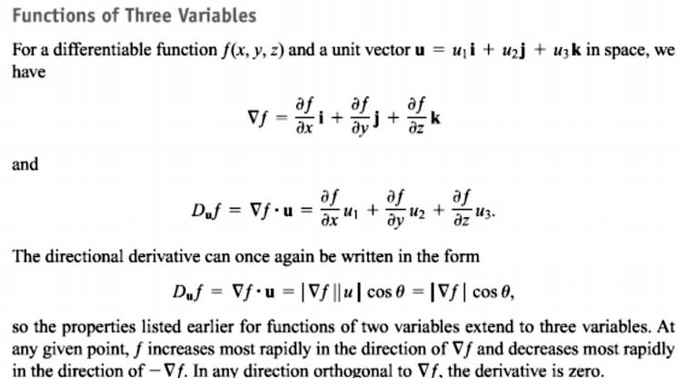
18 / Dep. Of Engineering Mechanics
th
Class: 2 AMTHMATICS / T he Partial Derivatives

Slide 19
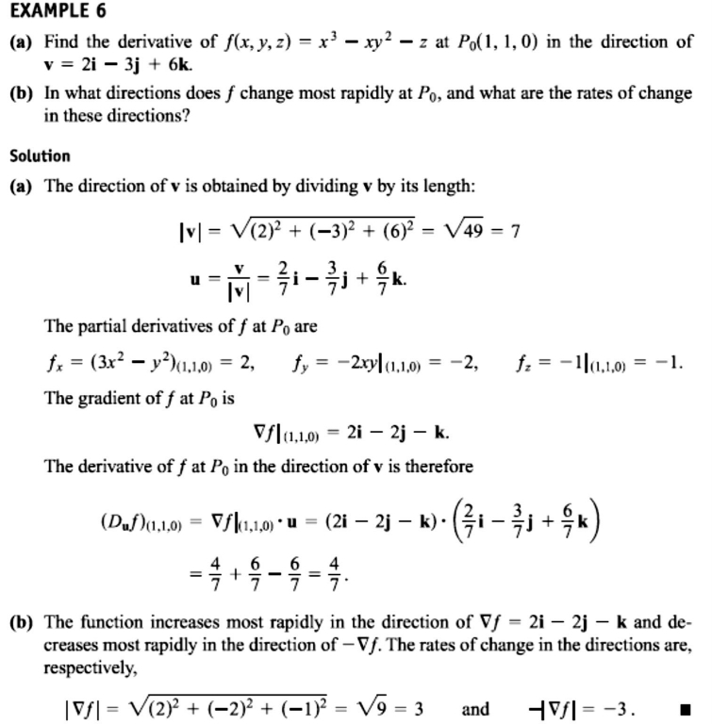
19 / Dep. Of Engineering Mechanics
th
Class: 2 AMTHMATICS / T he Partial Derivatives

Slide 20
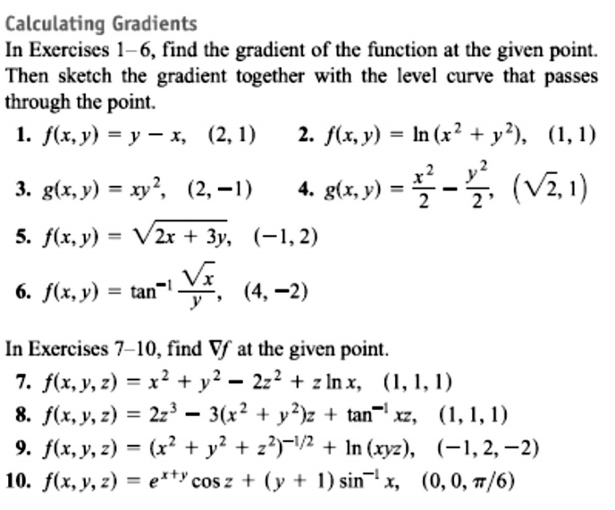
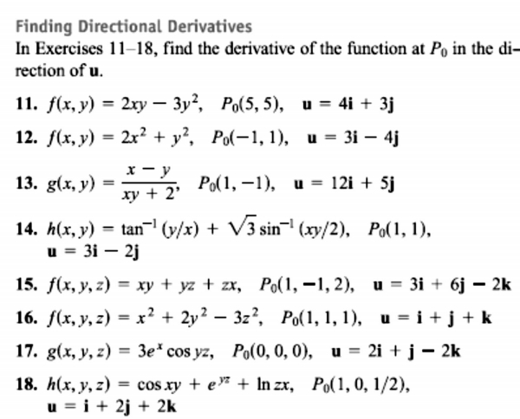
20 / Dep. Of Engineering Mechanics
th
Class: 2 AMTHMATICS / T he Partial Derivatives

Slide 21
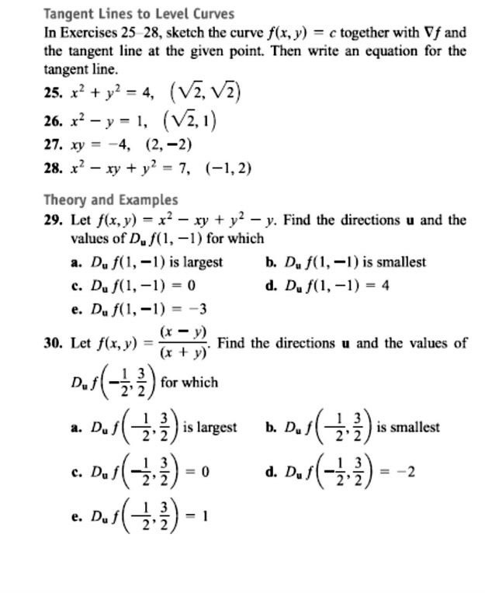
21 / Dep. Of Engineering Mechanics
th
Class: 2 AMTHMATICS / T he Partial Derivatives

Slide 22
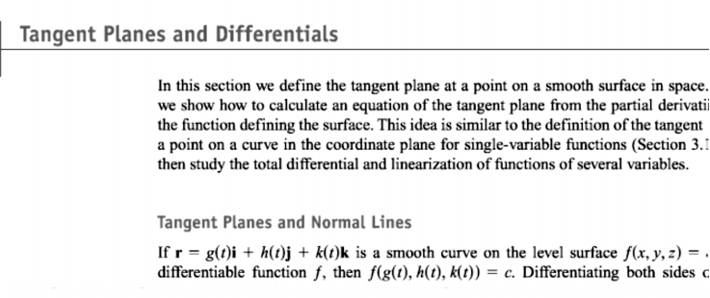
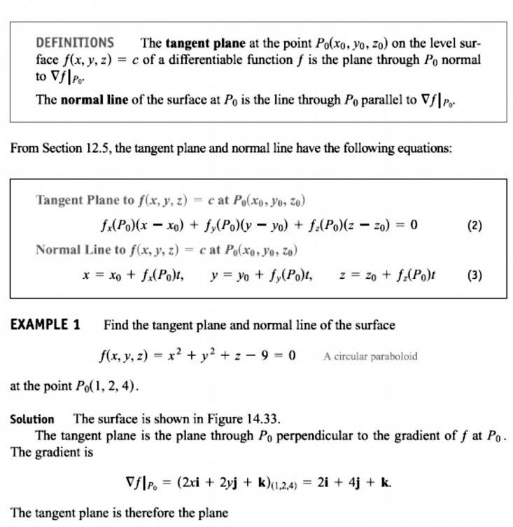
22 / Dep. Of Engineering Mechanics
th
Class: 2 AMTHMATICS / T he Partial Derivatives

Slide 23
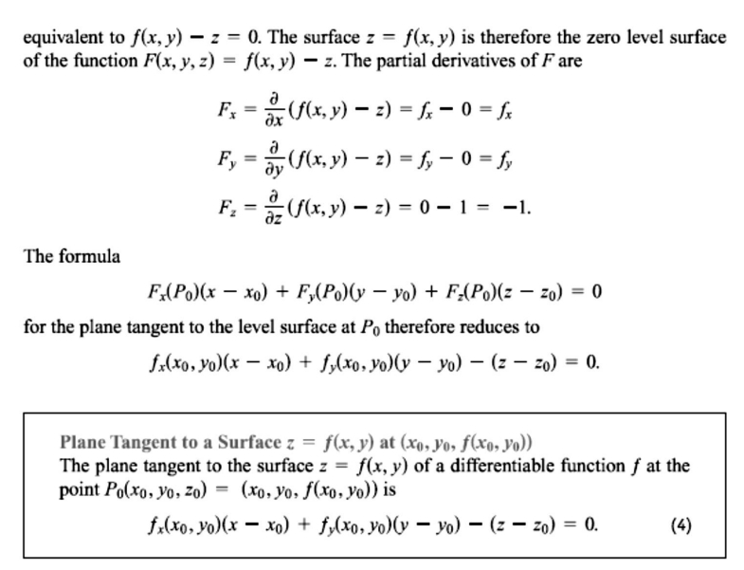
23 / Dep. Of Engineering Mechanics
th
Class: 2 AMTHMATICS / T he Partial Derivatives

Slide 24
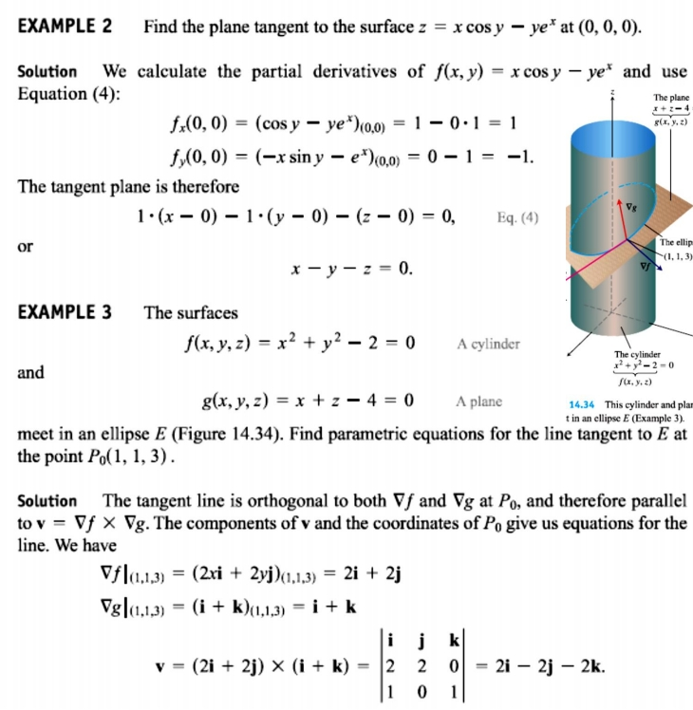
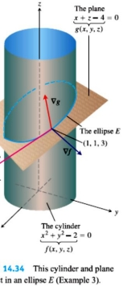
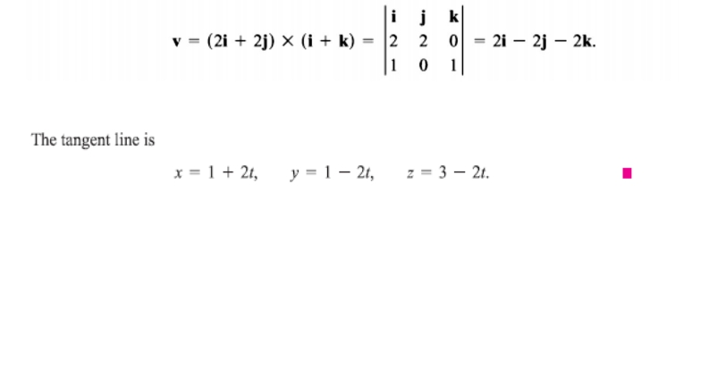
24 / Dep. Of Engineering Mechanics
th
Class: 2 AMTHMATICS / T he Partial Derivatives

Slide 25
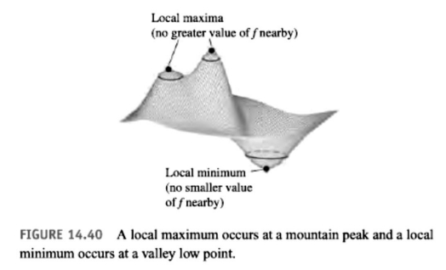
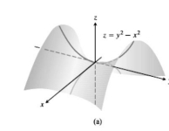
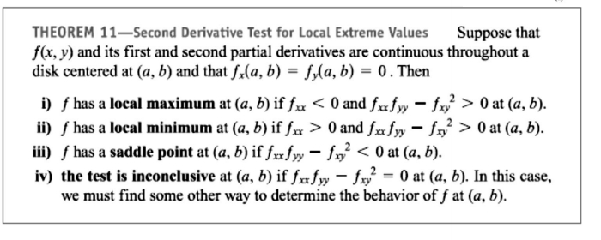
25 / Dep. Of Engineering Mechanics
th
Class: 2 AMTHMATICS / T he Partial Derivatives

Slide 26
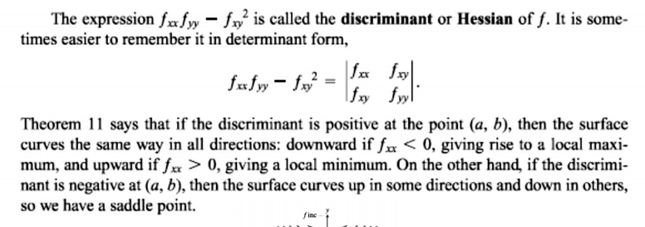
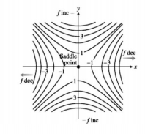
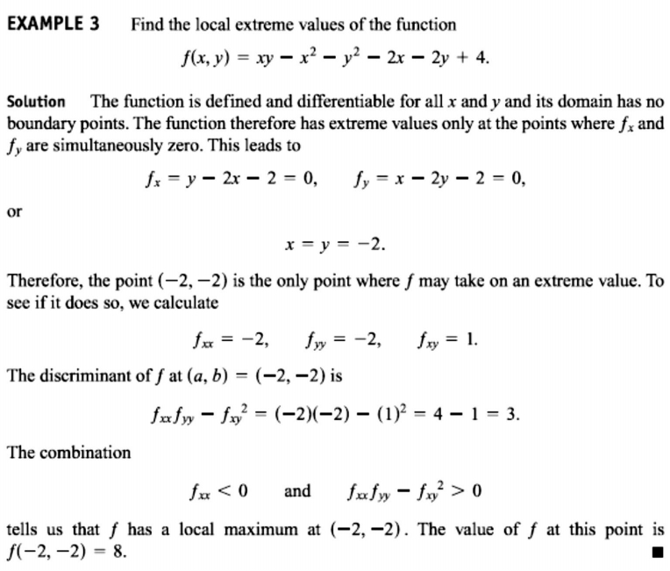
26 / Dep. Of Engineering Mechanics
th
Class: 2 AMTHMATICS / T he Partial Derivatives

Slide 27
27 / Dep. Of Engineering Mechanics
th
Class: 2 AMTHMATICS / T he Partial Derivatives

Slide 28
28 / Dep. Of Engineering Mechanics
th
Class: 2 AMTHMATICS / T he Partial Derivatives

Slide 29
29 / Dep. Of Engineering Mechanics
th
Class: 2 AMTHMATICS / T he Partial Derivatives

Slide 30
30 / Dep. Of Engineering Mechanics
th
Class: 2 AMTHMATICS / T he Partial Derivatives

Slide 31
31 / Dep. Of Engineering Mechanics
th
Class: 2 AMTHMATICS / T he Partial Derivatives

Slide 32
32 / Dep. Of Engineering Mechanics
th
Class: 2 AMTHMATICS / T he Partial Derivatives

Slide 33
33 / Dep. Of Engineering Mechanics
th
Class: 2 AMTHMATICS / T he Partial Derivatives

